Slide 1


Topic Model
Improvements

Slide 2
Agenda
High level overview of changes
Sonnet Topic Model Changes
NBS Topic Model Changes
Notes:
Assumed objectives are reports live asap.

Slide 3
Overview

Slide 4
Topic Report Overview - Estimate
Aim to deliver these model updates to Dev by end of week ending 29th Nov.
 | Sonnet | NBS
Scoring in provided baseline | 75% | 59%*
Scoring provided in baseline including missed data** | 72% | 61%
Scoring re-baselined to Nov 11th model |  | 64%
Anticipated range possible without prompt changes to requested baseline | 85-90% | 70-75%
* one call in sheet couldn’t be located in tool, this work was done on the model as of Oct 1st
** where prompt produces say 5 INTENT classes, but only 2 were reviewed by the Agents. (up to agent 3)

Slide 5
Topic Report Overview - Final
Final delivery made
 | Sonnet | NBS
Scoring in provided baseline | 75% | 59%*
Scoring provided in baseline including missed data** | 72% | 61%
Scoring re-baselined to Nov 11th model |  | 64%
Anticipated range possible without prompt changes to requested baseline | 90% | 81%
* one call in sheet couldn’t be located in tool, this work was done on the model as of Oct 1st
** where prompt produces say 5 INTENT classes, but only 2 were reviewed by the Agents. (up to agent 3)

Slide 6
Sonnet - Topic Model

Slide 7
Observations
The prompt on average generates around 4 Intents per call (sometimes up to 7)
A large portion (~30-40%) of intents generated were “missing” from the testing set (possibly due to confidence clip threshold of 0.3)
The baseline used six annotators (agents) we've consolidated them into a single sheet and noted the annotator.
The annotators didn't overlap on any calls so have not tried to investigate alignment but have carried their comments forward verbatim.
86 predictions up to annotator 3 (“Agent 3”) have been manually verified as CORRECT / INCORRECT / AMBIGUOUS

Slide 8
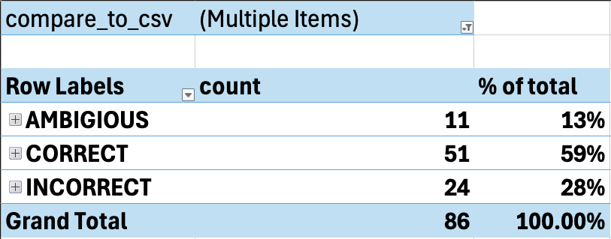
Scoring - Before (intent)
The scoring results rebaseline to the early model changes in DEV
Including PRESENT and MISSING Intents:
72% correct / 28% incorrect (86 predictions up to agent 3)
Rakesh’s original results were around 75% / 25%
The score likely decreases as the “missing” predictions are likely due to the 0.3 confidence filter on the reports hiding predictions that weren’t well covered
Including all generated predictions (up to agent 3)

Slide 9
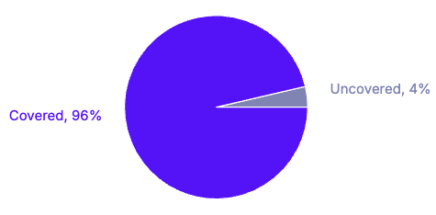
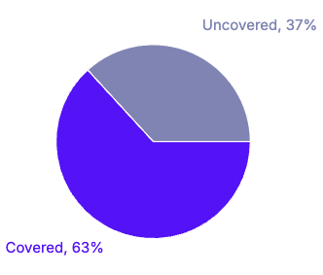
Model Changes
Coverage @0.3 confidence (latest)
58 intents → 95 intents
2021 labelled phrases → 4385 labelled phrases
88 F1 score → 89 F1 score
Strengthened multiple intents, removed confusion, and increased coverage on generated intents
Coverage @0.7 confidence (latest)

Slide 10
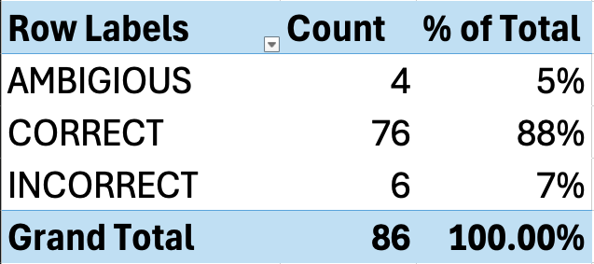
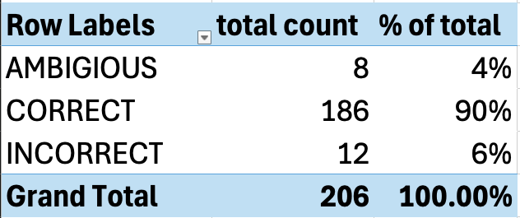
Scoring - After (intent)
The latest scoring results post changes:
Including only 86 generated intents:
88% correct / 5% ambiguous / 7% incorrect (86 intents)
Including all generated intents for full set of call ids:
90% correct / 4% ambiguous / 6% incorrect (206 intents)
Note: A lot of the improvements made were around the failure cases of this test set and thus these numbers are somewhat over-fit towards the baselined results. However there was a significant amount of labelling and granularity added to the model.
Including ONLY same predictions (up to agent 3)
Including entire full set (all agents)

Slide 11
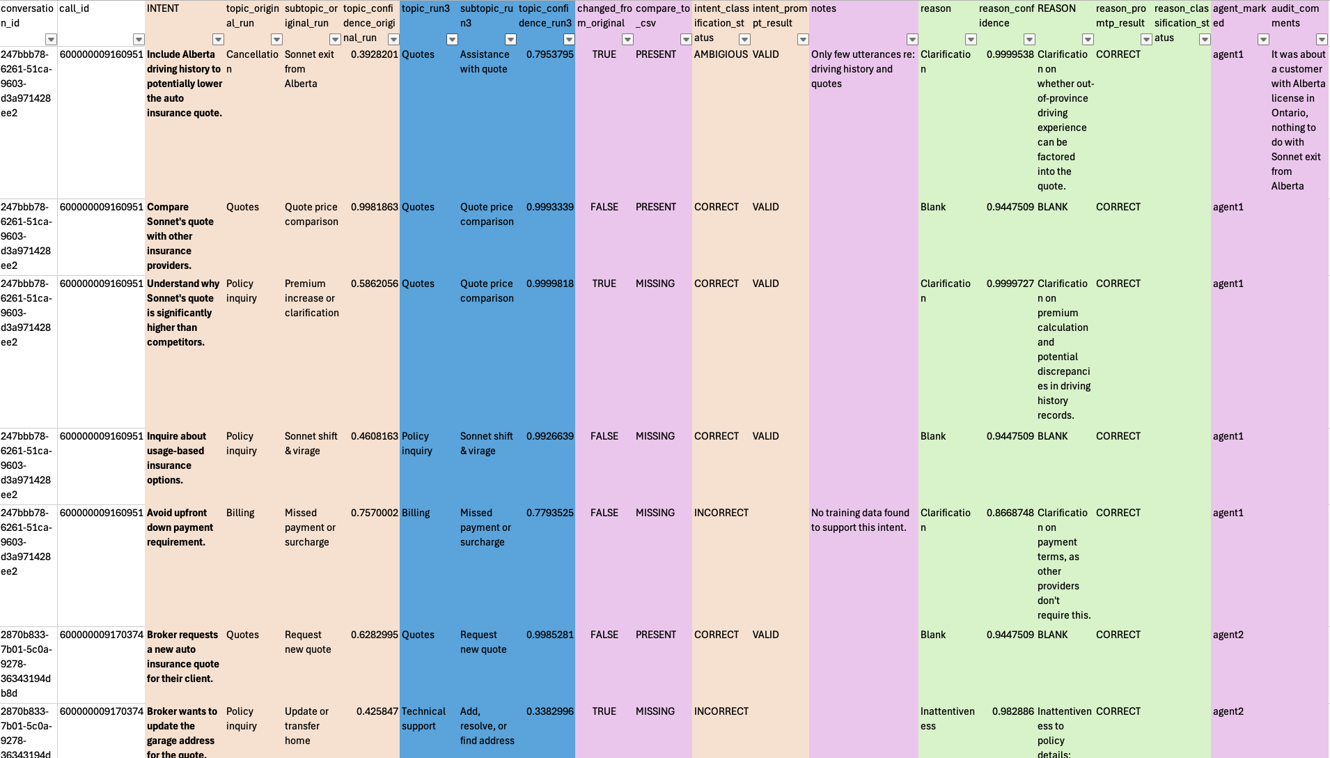

Slide 12
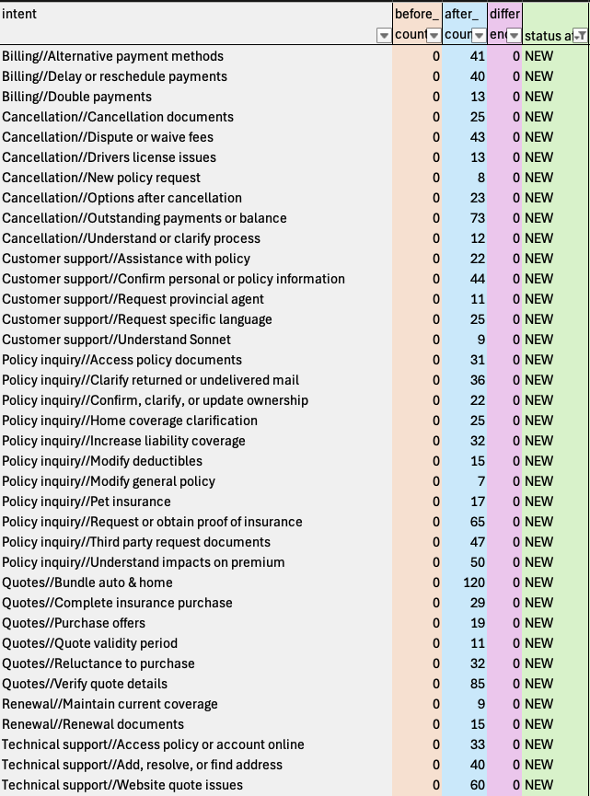
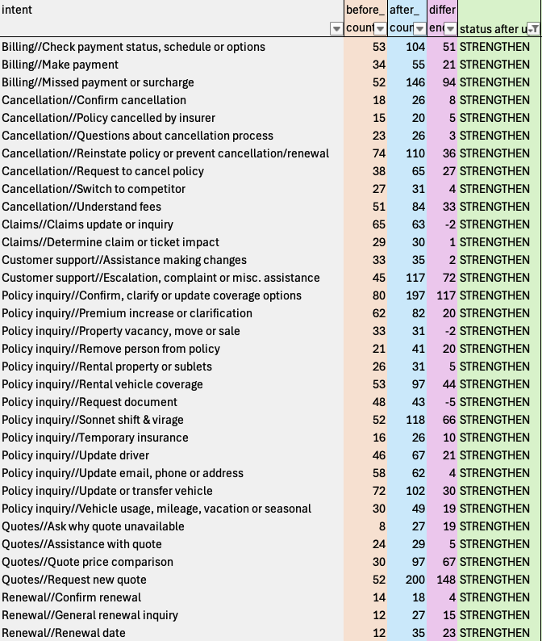
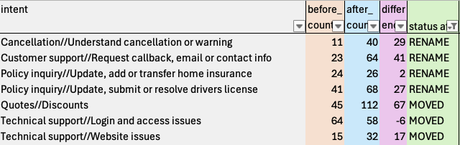
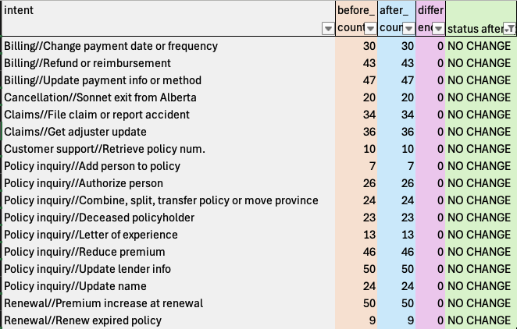
Net New Classes (37 classes)
Strengthened Classes (34 classes)
Rename/Moved Classes (7 classes)
No Change Classes (17 classes)

Slide 13
Billing//Alternative payment methods
Billing//Change payment date or frequency
Billing//Check payment status, schedule or options
Billing//Delay or reschedule payments
Billing//Double payments
Billing//Make payment
Billing//Missed payment or surcharge
Billing//Refund or reimbursement
Billing//Update payment info or method
Cancellation//Cancellation documents
Cancellation//Confirm cancellation
Cancellation//Dispute or waive fees
Cancellation//Drivers license issues
Cancellation//New policy request
Cancellation//Options after cancellation
Cancellation//Outstanding payments or balance
Cancellation//Policy cancelled by insurer
Cancellation//Questions about cancellation process
Cancellation//Reinstate policy or prevent cancellation/renewal
Cancellation//Request to cancel policy
Cancellation//Sonnet exit from Alberta
Cancellation//Switch to competitor
Cancellation//Understand cancellation or warning
Cancellation//Understand fees
Cancellation//Understand or clarify process
Claims//Claims update or inquiry
Claims//Determine claim or ticket impact
Claims//File claim or report accident
Claims//Get adjuster update
Customer support//Assistance making changes
Customer support//Assistance with policy
Customer support//Confirm personal or policy information
Customer support//Escalation, complaint or misc. assistance
Customer support//Request callback, email or contact info
Customer support//Request provincial agent
Customer support//Request specific language
Customer support//Retrieve policy num.
Customer support//Understand Sonnet
Policy inquiry//Access policy documents
Policy inquiry//Add person to policy
Policy inquiry//Authorize person
Policy inquiry//Clarify returned or undelivered mail
Policy inquiry//Combine, split, transfer policy or move province
Policy inquiry//Confirm, clarify or update coverage options
Policy inquiry//Confirm, clarify, or update ownership
Policy inquiry//Deceased policyholder
Policy inquiry//Home coverage clarification
Policy inquiry//Increase liability coverage
Policy inquiry//Letter of experience
Policy inquiry//Modify deductibles
Policy inquiry//Modify general policy
Policy inquiry//Pet insurance
Policy inquiry//Premium increase or clarification
Policy inquiry//Property vacancy, move or sale
Policy inquiry//Reduce premium
Policy inquiry//Remove person from policy
Policy inquiry//Rental property or sublets
Policy inquiry//Rental vehicle coverage
Policy inquiry//Request document
Policy inquiry//Request or obtain proof of insurance
Policy inquiry//Sonnet shift & virage
Policy inquiry//Temporary insurance
Policy inquiry//Third party request documents
Policy inquiry//Understand impacts on premium
Policy inquiry//Update driver
Policy inquiry//Update email, phone or address
Policy inquiry//Update lender info
Policy inquiry//Update name
Policy inquiry//Update or transfer vehicle
Policy inquiry//Update, add or transfer home insurance
Policy inquiry//Update, submit or resolve drivers license
Policy inquiry//Vehicle usage, mileage, vacation or seasonal
Quotes//Ask why quote unavailable
Quotes//Assistance with quote
Quotes//Bundle auto & home
Quotes//Complete insurance purchase
Quotes//Discounts
Quotes//Purchase offers
Quotes//Quote price comparison
Quotes//Quote validity period
Quotes//Reluctance to purchase
Quotes//Request new quote
Quotes//Verify quote details
Renewal//Confirm renewal
Renewal//General renewal inquiry
Renewal//Maintain current coverage
Renewal//Premium increase at renewal
Renewal//Renew expired policy
Renewal//Renewal date
Renewal//Renewal documents
Technical support//Access policy or account online
Technical support//Add, resolve, or find address
Technical support//Login and access issues
Technical support//Website issues
Technical support//Website quote issues
Full Taxonomy (95 classes)

Slide 14
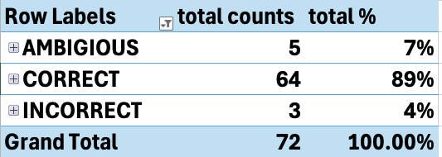
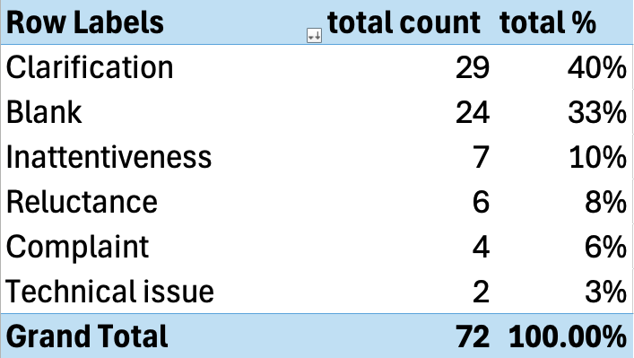
Sonnet Reason Model
Rebaseline 72 individual reasons generated using manual verification:
~89% correct / 7% ambiguous / 4% incorrect
Given the high scoring there were no changes made to the reason model
The “Blank” prediction class (33%) is expected as:
Prompt is setup to generate a “reason” for each intent
“Why the customer reached out to an agent rather than solving their issue through self-serve options.”
This is expected behaviour as the LLM is not making up a reason if it doesn’t exist for that intent within the context of the above line
INTENT: Discuss bundling home and auto insurance in the future. REASON: Blank
Manual verification of prompt (up to agent 3)
Distribution over the 72 predictions

Slide 15
NBS - Topic Model

Slide 16
Observations
The prompt on average generates around 2 Intents (sometimes up to 9) per call
The baseline used two annotators (agents) we've consolidated into a single tab and noted the annotator.
The annotators didn't overlap on any calls so have not tried to investigate alignment but have carried their comments forward verbatim.

Slide 17
Baseline
NBS Baseline had 42 calls in it, one of which we couldn't locate in the provided datasets on HF to examine
The baseline as provided was 25/41 (61%)

Slide 18
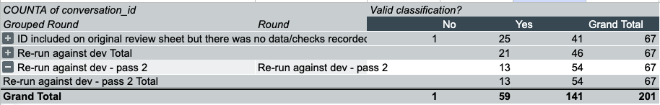
Missing Data and Update model
Examining it, it was clear it was missing a lot of data that is present in HF for instance where multiple classes had been predicted not all of those were on the Baseline. Sometimes those extra categories already satisfied the Agents comment.
Adding that data in brought the result to 41/66 (62%)
The baseline was run on QA with October 1st model without the updates that were made on Dev.
Re-running the test call set in DEV and aligning the original agent comments against the current model gives 46/67 (69%)
Final number after all model changes was 54/67 (81%)

Slide 19
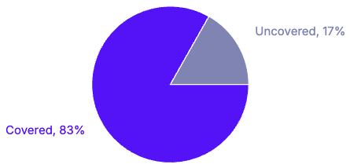
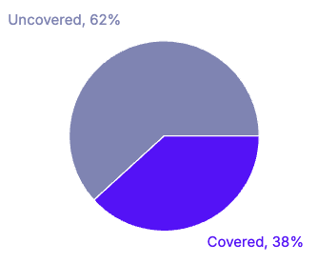
Model Changes
Coverage @0.3 confidence (latest)
84 intents → 89 intents
2464 labelled phrases → 2560 labelled phrases
87 F1 score → 87 F1 score
Fixed a large amount of confusion between the existing intents and separated out a few new intents
These were the changes possible given the current prompt and avoiding a complete model re-work
Coverage @0.7 confidence (latest)

Slide 20
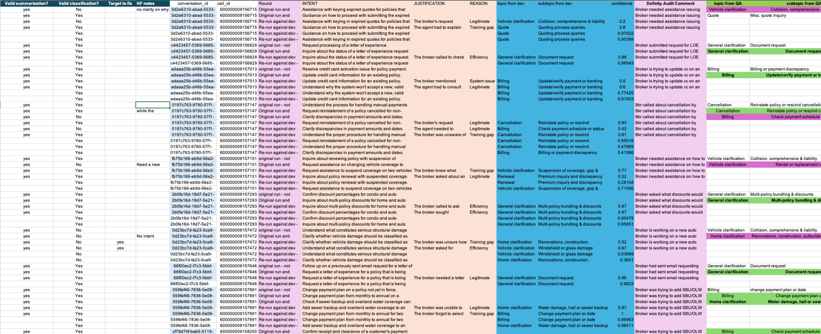

Slide 21
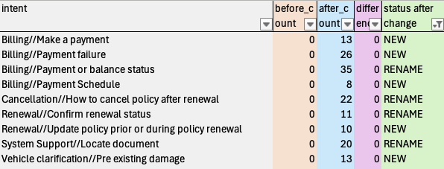
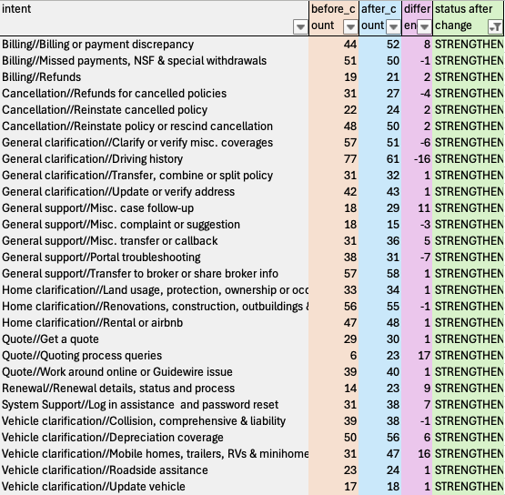
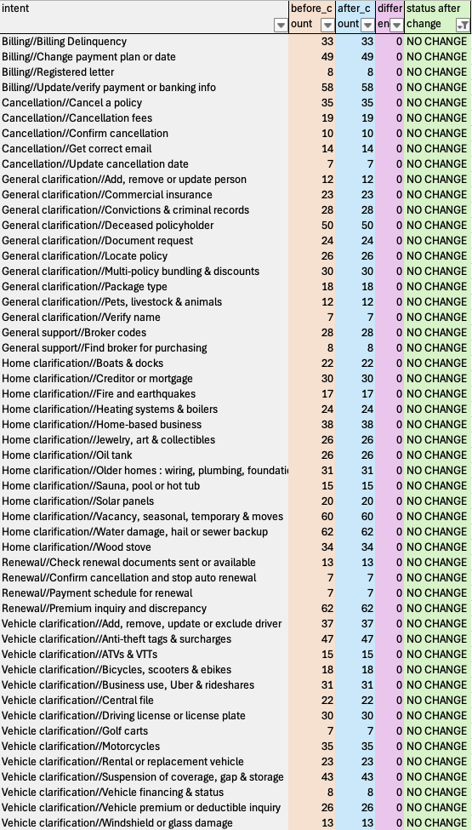
New/Rename/Moved Classes(9 classes)
Strengthened Classes (28 classes)
No Change Classes (52 classes)

Slide 22
Billing//Billing Delinquency
Billing//Billing or payment discrepancy
Billing//Change payment plan or date
Billing//Make a payment
Billing//Missed payments, NSF & special withdrawals
Billing//Payment failure
Billing//Payment or balance status
Billing//Payment Schedule
Billing//Refunds
Billing//Registered letter
Billing//Update/verify payment or banking info
Cancellation//Cancel a policy
Cancellation//Cancellation fees
Cancellation//Confirm cancellation
Cancellation//Get correct email
Cancellation//How to cancel policy after renewal
Cancellation//Refunds for cancelled policies
Cancellation//Reinstate cancelled policy
Cancellation//Reinstate policy or rescind cancellation
Cancellation//Update cancellation date
General clarification//Add, remove or update person
General clarification//Clarify or verify misc. coverages
General clarification//Commercial insurance
General clarification//Convictions & criminal records
General clarification//Deceased policyholder
General clarification//Document request
General clarification//Driving history
General clarification//Locate policy
General clarification//Multi-policy bundling & discounts
General clarification//Package type
General clarification//Pets, livestock & animals
General clarification//Transfer, combine or split policy
General clarification//Update or verify address
General clarification//Verify name
General support//Broker codes
General support//Find broker for purchasing
General support//Misc. case follow-up
General support//Misc. complaint or suggestion
General support//Misc. transfer or callback
General support//Portal troubleshooting
General support//Transfer to broker or share broker info
Home clarification//Boats & docks
Home clarification//Creditor or mortgage
Home clarification//Fire and earthquakes
Home clarification//Heating systems & boilers
Home clarification//Home-based business
Home clarification//Jewelry, art & collectibles
Home clarification//Land usage, protection, ownership or occupancy
Home clarification//Oil tank
Home clarification//Older homes : wiring, plumbing, foundations or roof
Home clarification//Renovations, construction, outbuildings & property type
Home clarification//Rental or airbnb
Home clarification//Sauna, pool or hot tub
Home clarification//Solar panels
Home clarification//Vacancy, seasonal, temporary & moves
Home clarification//Water damage, hail or sewer backup
Home clarification//Wood stove
Quote//Get a quote
Quote//Quoting process queries
Quote//Work around online or Guidewire issue
Renewal//Check renewal documents sent or available
Renewal//Confirm cancellation and stop auto renewal
Renewal//Confirm renewal status
Renewal//Payment schedule for renewal
Renewal//Premium inquiry and discrepancy
Renewal//Renewal details, status and process
Renewal//Update policy prior or during policy renewal
System Support//Locate document
System Support//Log in assistance and password reset
Vehicle clarification//Add, remove, update or exclude driver
Vehicle clarification//Anti-theft tags & surcharges
Vehicle clarification//ATVs & VTTs
Vehicle clarification//Bicycles, scooters & ebikes
Vehicle clarification//Business use, Uber & rideshares
Vehicle clarification//Central file
Vehicle clarification//Collision, comprehensive & liability
Vehicle clarification//Depreciation coverage
Vehicle clarification//Driving license or license plate
Vehicle clarification//Golf carts
Vehicle clarification//Mobile homes, trailers, RVs & minihomes
Vehicle clarification//Motorcycles
Vehicle clarification//Pre existing damage
Vehicle clarification//Rental or replacement vehicle
Vehicle clarification//Roadside assitance
Vehicle clarification//Suspension of coverage, gap & storage
Vehicle clarification//Update vehicle
Vehicle clarification//Vehicle financing & status
Vehicle clarification//Vehicle premium or deductible inquiry
Vehicle clarification//Windshield or glass damage
Full Taxonomy (89 classes)

Slide 23
Next steps

Slide 24
Next steps
Topic model updates in Dev week ending 29/11 and present 03/12 (Complete)
Deliver a staggered set of performance improvements to enable multi-dimensional running on frequent files updates
1.65 - Index download just in time rather than auto (Complete 21/11)
1.65.1 - Disable density features, provide await on new indexes and provide ability to upload files without index triggers (Complete 28/11)
Build representative test environment and test sequential and parallel scenarios at volume (Complete)
Continue supporting Advanced Analytics team and Deloitte with training or onboarding requirements.
Support any software defects found during your testing or production runs via the HF portal

Slide 25
Worked Example
Granularity

Slide 26
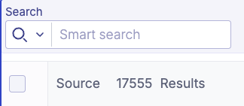
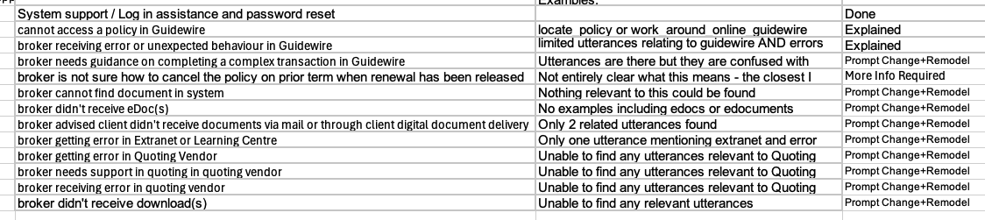
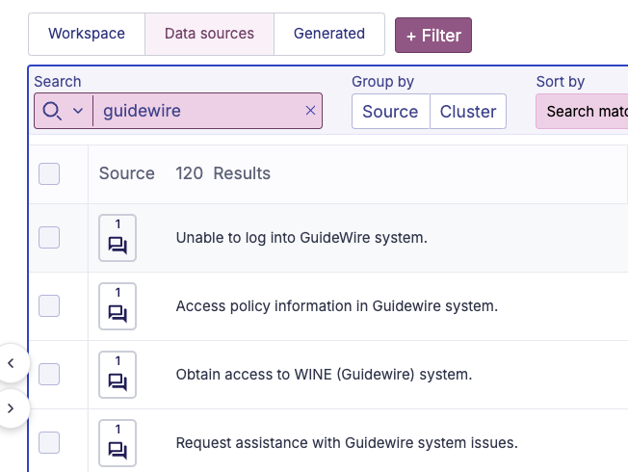
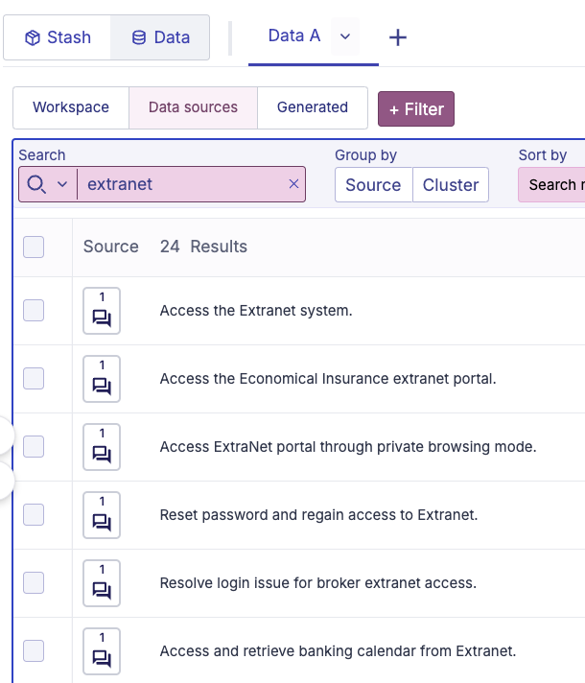
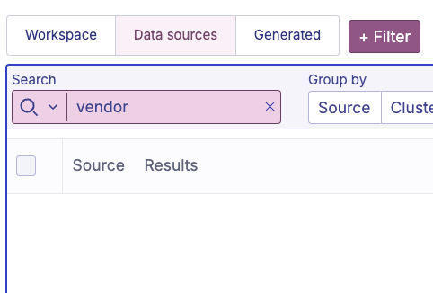
0.68%
120 / 17,555
0.13%
24 / 17,555
0%
0 / 17,555

Slide 27
Definity current prompt
You are an insurance expert tasked with extracting intents from a conversation transcript. This conversation is related to Economical insurance or National Broker Services, which supports Canadian brokerages managing customer policies. Agents field calls from brokers enquiring about specific issues that affect their clients. One call may span different policy holders.
Below is the original conversation from {{ meta "timestamp" }}, delimited by three backticks.
```
{{ conversation }}
```
Rules:
- Your task is to list the MAIN issues that the broker expressed to the agent.
- Be concise. Avoid including personal names, company names, policy numbers, amounts or dates.
- Intents stemming from the same initial issue should appear together.
- Completely different intents can be returned in different objects.
- Note that personal and identifiable information has been masked, so names and addresses might not be consistent.
- Return ONLY English text without headings, markdown or special characters.
- Note that some transcript roles may be incorrect.
- If the agent is not speaking to a broker, you must clarify that person' role : "customer", "bank representative", "police officer", etc.
- You must also extract the reason why the broker contacted an agent. This reason can be one of the 5 following options:
1. Training gap.
The broker could perform the task through their system, but they don’t know how to do it. The agent will coach the broker on accomplishing the task autonomously, for example in Guidewire or through a screen share.
2. System issue.
Brokers should have access to a self-serve system, but they will mention that it is not working as expected or that they don't have access.
3. Efficiency.
Brokers find it faster to call an agent than to search through their resources and manuals, which can include Broker Extranet, Definity Learning, Guidewire, or more broadly, the "portal". The agent will likely guide the broker to resources during an interaction of this type.
4. Legitimate.
The broker's request is complex and the agent interpreted the situation by relying on their specific expertise or internal knowledge base. For example, this could be a question related to multiple underwriting rules, or a billing issue that requires an agent's intervention.
5. BLANK.
If you cannot match an explicit part of the transcript to one of the four previous reasons, return this value.
Return key-value pairs in the following format:
INTENT: <This is a single sentence with a concise summary of the broker request.>
REASON: <one of the five options listed above that explains why the broker was not able to accomplish the action or resolve the issue on their own through digital channels>
JUSTIFICATION: <why you chose the reason, based on the information contained within the transcript>
Contained between hashtags is an example of key-value pairs.
###
INTENT: Check next payment date on a customer policy.
REASON : System issue
JUSTIFICATION : the broker mentioned that the system is freezing up and not working as intended
INTENT: Check customer eligibility for new policy according to their accident record and history of non-payment.
REASON: Legitimate
JUSTIFICATION : the request concerned a combination of two underwriting rules, which the agent was able to interpret jointly.
###
Notes:
Long complex Mixes two dimensions Hard to know what is going on. Provides examples Uses out of date ### ``` prompting style

Slide 28
Example NBS INTENT prompt
You are an insurance expert tasked with extracting intents from a conversation transcript.
This conversation is related to Economical insurance or National Broker Services, which supports Canadian brokerages managing customer policies. Agents marked as "Agent:" answer calls from Brokers marked as "User:" enquiring about specific issues that affect their clients. One call may span different policy holders.
Your task is to analyze this transcript and extract the broker's main issues as INTENT
<conversation_transcript>
{{ conversation }}
<\conversation_transcript>
<rules>
- There may be more than one main issue within each transcript, extract them all
- Be concise, your response should be a single sentence for each intent
<\rules>
Please answer in English, with plain text, with no markdown, as key-value pairs in the following format
INTENT: [A single concise sentence summarizing the first main issue]
INTENT: [A single concise sentence summarizing the second main issue]

Slide 29
Add one line
You are an insurance expert tasked with extracting intents from a conversation transcript.
This conversation is related to Economical insurance or National Broker Services, which supports Canadian brokerages managing customer policies. Agents marked as "Agent:" answer calls from Brokers marked as "User:" enquiring about specific issues that affect their clients. One call may span different policy holders.
Your task is to analyze this transcript and extract the broker's main issues as INTENT
<conversation_transcript>
{{ conversation }}
<\conversation_transcript>
<rules>
- There may be more than one main issue within each transcript, extract them all
- Be concise, your response should be a single sentence for each intent - Include relevant document names, systems and states/provinces
<\rules>
Please answer in English, with plain text, with no markdown, as key-value pairs in the following format
INTENT: [A single concise sentence summarizing the first main issue]
INTENT: [A single concise sentence summarizing the second main issue]

Slide 30
Add justification/explanation
You are an insurance expert tasked with extracting intents from a conversation transcript.
This conversation is related to Economical insurance or National Broker Services, which supports Canadian brokerages managing customer policies. Agents marked as "Agent:" answer calls from Brokers marked as "User:" enquiring about specific issues that affect their clients. One call may span different policy holders.
Your task is to analyze this transcript and extract the broker's main issues as INTENT
<conversation_transcript>
{{ conversation }}
<\conversation_transcript>
<rules>
- There may be more than one main issue within each transcript, extract them all
- Be concise, your response should be a single sentence for each intent - Include relevant document names, systems and states/provinces
<\rules>`
Please answer in English, with plain text, with no markdown, as key-value pairs in the following format
INTENT: [A single concise sentence summarizing the first main issue]
EXPLANATION: [Your reasoning for the above statement]
INTENT: [A single concise sentence summarizing the second main issue]
EXPLANATION: [Your reasoning for the above statement]

Slide 31
Example call - 600000007353307
Thanks for calling Economical, Madeline Yu speaking.
How may I help? Hi, Madeline Yu, how are you? It's Michael Aguilar calling from NFP Insurance. Hi, Melanie Cook, I'm calling on property policy for which the payment going up almost doubles. Just want to check it out, any reason. Can I give you the policy number?
Yeah, sure, but before we proceed, the number ending in 4106, is that a good callback number in case we get disconnected?
Yeah, yeah, that is a good one.
Okay, and go ahead with the policy number, please.
Yeah, that is a 419982615, sorry, different one. It should be 30207280. Sorry, 3020? 7280.
Perfect, thank you so much. And one minute there while I bring up the policy. Can you confirm the full name of the insured, please?
That is for Kristen Herrera. Okay. Or Erika Garcia Kristen Herrera. Perfect, thank you so much.
One minute there. So you're saying that the price went up since last year to this year?
Last year. Yeah, last year, you know, like a 1042, and this year it's 1771, like 60% up, is it? 80% or 60%? 1771 minus 1042 divided by 1042, nice, 70% up.
One minute there, I'm just reviewing, okay?
Okay, thank you so much, Eric Navarro. One second.
All right, so what I'm seeing, the major difference that I'm seeing, I noticed that you are in an unprotected area with this location, and the rates for this unprotected zone, the rates have gone up significantly, and that's what's impacting the premium.
So you mean like this one before, it is unprotected?
Correct.
It's a hydrogen protected, hydrogen protected before it's hydrogen protected, but now it's a semi-protected, is that correct?
It was not hydrogen protected before. Is this location?
Yeah, location, what is it before, last year?
It's the same protection as last year, but our ratings have gone up for unprotected areas, because it's a first grade four, and last year it was a first grade four, but our rates have gone up for unprotected areas.
Wow, that's a big difference.
Yeah.
How can I see that it's unprotected area? Can you click on the dwelling tab? Yep, yeah, yes, I'm there.
And where you see first grade, and it has the four there, that means it's unprotected, it's neither fire hall or fire hydrant protected.
Okay, I'm on the drawing, okay? So, you know, like we have a resident type, okay, construction type.
Resident type, yes.
And then it will be, you know, like on the left side or on the right side, saying that-
So, up at the top, above that, where you see first grade, so you see the location name, and then underneath it, it shows first grade four, on the left-hand side.
Yeah.
Yeah, it shows first grade four, so you see the construction type, then if you go up, you see resident type, up at the top, you see first grade four.
I still not seeing it.
Okay, up at the top of your screen, by any chance, are you seeing this option called co-browsing beside desktop, account, policy number, policy contact, do you see an option? If you click on it and provide me with the four-digit code, I can actually view your screen, so I can point it out to you. Is it possible for you to do that for me, please? Yeah, sure. Go ahead with the four-digit number, when you click on that. Where, under the where? Up at the top, where it has desktop, account, policy. Oh, co-browse, is it co-browse? Yeah, co-browse. Okay. Can you click on that and give me the four-digit number, please?
Okay, so it's 1988. Thank you so much.
Thank you. So, I'm coming into your screen right now for the system. So, can you click here for me, please? And why is it not showing it on yours? All right. Can you click here, please? Summary. Yes, please. And can you click here, please? And dwelling. It does not show it on yours. Okay, it doesn't show the first grade on yours. I understand now what you're saying. So, basically, we have this location as an unprotected location.
Unprotected location?
Yeah.
There is no fire hall within 13 kilometers? Correct.
And no fire hydrants within three kilometers.
Okay, how can you know that it's unprotected? The system- Is it like, you know- Our system is- The system will provide the address?
Yes, it pulls by the address and it basically, the fire hall and the fire hydrants, it picks up all of that information and uploads in the system.
It is unprotected area? Automatically, the information, definitely, it's correct, right?
Yes.
Because it's a code? Yeah. Okay, okay, okay. So, it's unprotected area, that is a reason for the premium going up? Correct. Unprotected. Give me one second. Not this con, no. But how comes, you know, like, you can see, however, I cannot see. Let me just pull that up, you know, pull up that decoration, will be see unprotected. Okay. Because you can't be able to see, but if I can't, so when I have to review the coverage with the client, so I have some problem. Okay, so, you know, like, unlimited. Even though for the policy declaration, it doesn't show, it is like a semi-protected or unprotected.
Let me look on the declaration page to see how it's reflected. One minute, please. I'm just waiting for the declaration page to open on my screen.
Sure, sure.
Sure, take your time. All right, can you hold three to five minutes for me, please?
Thank you. Okay.
System support Lidia speaking, how can I help you?
Hi Karen Mcconnell again, how are you? Hi Steven Flowers, I'm good. Are we only two people who work today? Yes.
How can I help you? Yeah, policy number 30207280, Erika Garcia Kristen Herrera.
Thank you. Give me just a moment, please, to open the policy. Sure. OK, have it over here. How can I help?
On the dwelling tab, I was just wondering, in regards to the broker, is the broker supposed to be able to see what the FOSGRADE is on the system?
I don't think so. I don't think so. Yes, they are able to see. We can see, but not them. So yes. What is happening?
So I thought they could have seen. I was not aware. So I was actually telling her, showing her where to go and find the FOSGRADE. When I went and did the agent, the co-browsing, I realized that she couldn't see. And she wanted to know where in the system or where can they find out that locations are unprotected or how we're rating it. And I was looking on the declaration page. I wasn't seeing it. So I was wondering, how in the system does the broker know that we're rating it as an unprotected location?
That's a good question. I have checked that as well, Madeline Yu. I didn't have that question before. So honestly, I don't know. So yeah, what is the broker's name?
Her name is Michael Aguilar.
Michael Aguilar? OK. OK. You can transfer call and I'll see. So you said you already checked our declaration sheet and it's nothing there?
Nothing is on it showing that the location is unprotected and they're not able to see the FOSGRADE. So it's almost like how, because that's something that I thought they should be able to see how we're rating the policy. Right.
OK. Yeah. I can open inquiry and address that to IT and see how they can see. But yeah, honestly, no idea how they can see. That's a good question. Yeah, you can transfer call to me and I'll check into that. All right. Thank you so much. You are welcome. Oh, please. System support, Lydia speaking. How can I help you?
Hi, Hannah Little. Madeline Yu again. How are you? Cynthia Parker. I'm good. Are we only two people who work today?
Yeah. How can I help you? Yeah. Policy number 30207280, Erika Garcia Kristen Herrera.
Thank you. Give me just a moment, please, to open the policy. Sure. OK, have it over here. How can I help?
On the dwelling tab, I was just wondering in regards to the broker, is the broker supposed to be able to see what the FOSGRADE is on the system?
I don't think so. I don't think so. They are, yes, they are able to see. We can see, but not them. So, yes. What is happening?
So I thought they could have seen. I was not aware. So I was actually telling her, showing her where to go and find the FOSGRADE. When I went and did the agent, the co-browsing, I realized that she couldn't see. And she wanted to know where in the system or where can they find out that locations are unprotected or how we're rating it. And I was looking on the declaration page. I wasn't seeing it. So I was wondering, how in the system does the broker know that we're rating it as an unprotected location?
That's a good question. Yeah, I have checked that as well, Madeline Yu. I didn't have that question. Yeah, before. So honestly, I don't know. So, yeah. What is the broker's name?
Her name is Michael Aguilar.
Michael Aguilar, OK. OK. You can transfer call and I'll see. So you said you already checked our declaration sheet and it's nothing there?
Nothing is on it showing that the location is unprotected. And they're not able to see the FOSGRADE. So it's almost like how, because that's something that I thought they should be able to see how we're rating the policy.
Right, OK. Yeah, I can open inquiry and address that to IT and see how they can see. But yeah, honestly, no idea how they can see. That's a good question. Yeah, you can transfer call to me and I'll check into that. All right, thank you so much. You are welcome. Cool, please. Hello, Michael Aguilar. Hi. Yes. Hi, it's Hannah Little from Broker Support. Good, thank you. How are you this morning? I'm doing good. Thanks for asking. You know, like I'm going on, you know, which person about, you know, like, have you bring it up, the policy number yet? Yes, Madeline Yu told me about David Garcia and he's a broker. And you would like to know how you can see and where you can see about information for dwelling protection, right? Mm-hmm. OK, so yeah, I checked declaration sheet and there is nothing there. When you are on the Guidewire Policy Center on the dwelling tab, what you can see? OK, did Madeline Yu follow you on Glens on the co-browser and saw your page? Uh-huh. And... She did. OK. Nothing can... Nothing. OK, so nothing there as well, right? OK, so I have to open a case and I have to ask our leadership where actually you can and how you can see that information as like you don't see based on the history tab on dwelling in the Guidewire. History type? I'm sorry. History type? No, no. I want to say when you go on our Guidewire Policy Center and even when you click on the history, there is not any information on prior documents as of renewal as well about protection of the location. Correct.
Yes.
Correct. OK, so I open a case and I have to report that to my leadership team to ask them where you can find that. OK, case number is inquiry. What is the case number? 00176052. OK, the case number is 00176052. Yes, that's the one. Is there any number before 00? It's [spelled], like a technical case. OK, OK. [spelled] case, yes. So as soon as I find out their response and how we can advise you where you can see it, I'll let you know. OK, you mean like where I can see it on the Guidewire or on the policy declaration? Exactly, yes, because I also checked declaration sheet when I was waiting for your transfer. I didn't see it anywhere as well. Yeah. Yeah. Is it only for the particular for this one or, you know, like it's generally for all economic policy? Yeah, this is what I have to find out because, honestly, I never had that question before, so I have to search more. OK, so now I'm... Can you give me one second, OK? So now I'm going to check it out the last year. It will be on the policy declaration. It will be so, you know, like the... I mean the location protection area. Give me one second, OK? OK. Yep. Let me search it all. Last year... Last year, same thing. It doesn't show if it's unprotected area or... Or unprotected or... Yeah, OK. So if, you know, insurer can be able to provide a letter from the fire hall saying that, you know, like the responding fire hall is only within 10 kilometres, so the premium could be lower, right? That's correct. Because now it's rated unprotected. Right, yes, yes. But is it that it's the only thing... It's the only document you accept? But however, are you able to Google it, you know, like from the nearest fire halls? So this is what I am not sure because I am broker support specialist. I just can help you in regards to issue in the system. This is more like an underwriting thing that they have to... Or underwriting specialists, they have to check with you, but we don't do that. So I can check for where you can see it or if anywhere possible to see for you as a broker and as a client is home protected or semi-protected or unprotected. OK. Yeah. OK. Thank you so much. You are so very welcome, Michael Aguilar. Thank you for calling. Have a nice day. OK, take care. Bye-bye. Thanks. Bye now.
Notes:
Very long document with complicated subject. Summary must be tailored at the dimensions

Slide 32
With document/system guidance and explanation
Example Prompt
Broker seeking clarification on how to view or determine a property's protection status (unprotected/semi-protected) in the insurance system.
Broker is seeking information on how to prove a property is protected to potentially lower the premium.
Broker inquiring about a significant premium increase for a property policy.
Broker wants to understand why the premium for policy 30207280 increased by 70% due to the property being in an unprotected area.
Broker cannot see the FOSGRADE or protection status of a property in the Guidewire Policy Center system.
Notes:
600000007353307

Slide 33
With document/system guidance and explanation
Example Prompt
Broker seeking clarification on how to view or determine a property's protection status (unprotected/semi-protected) in the insurance system.
Broker is seeking information on how to prove a property is protected to potentially lower the premium.
Broker inquiring about a significant premium increase for a property policy.
Broker wants to understand why the premium for policy 30207280 increased by 70% due to the property being in an unprotected area.
Broker cannot see the FOSGRADE or protection status of a property in the Guidewire Policy Center system.
A taxonomy built around these
Will be very different to one built around these
Notes:
600000007353307

Slide 34
Summary of results
 | Example Prompt | Prompt asks for intent including document names, systems, province/state | Prompt asks for intent including document names, systems, province/state Asks for explanation as well | Example Prompt with Definity Examples added.
Total PHONEs/CHATs | 5000 | 5000 | 5000 | 5000
Total Results | 10460 | 10648 | 12439 | 11247
Average INTENT per call | 2.092 | 2.1296 | 2.4878 | 2.2494
Search term
Guidewire | 156 | 606 | 594 | 87
Corelogic | 1 | 2 | 1 | 0
Pathway | 0 | 2 | 2 | 3
Extranet | 37 | 58 | 63 | 18
Ontario | 38 | 278 | 359 | 37
Alberta | 17 | 40 | 47 | 20
PEI | 1 | 6 | 9 | 1
DMTI | 4 | 9 | 9 | 1
ARS | 4 | 14 | 12 | 2
CompiQuote | 12 | 23 | 24 | 7

Slide 35
Add example from
current dev prompt
Contained between hashtags is an example of key-value pairs.
###
INTENT: Check next payment date on a customer policy.
REASON : System issue
JUSTIFICATION : the broker mentioned that the system is freezing up and not working as intended
INTENT: Check customer eligibility for new policy according to their accident record and history of non-payment.
REASON: Legitimate
JUSTIFICATION : the request concerned a combination of two underwriting rules, which the agent was able to interpret jointly.
###

Slide 36
Added here
You are an insurance expert tasked with extracting intents from a conversation transcript.
This conversation is related to Economical insurance or National Broker Services, which supports Canadian brokerages managing customer policies. Agents marked as "Agent:" answer calls from Brokers marked as "User:" enquiring about specific issues that affect their clients. One call may span different policy holders.
Your task is to analyze this transcript and extract the broker's main issues as INTENT
<conversation_transcript>
{{ conversation }}
<\conversation_transcript>
<rules>
- There may be more than one main issue within each transcript, extract them all
- Be concise, your response should be a single sentence for each intent
<\rules>
<example_response>
INTENT: Check next payment date on a customer policy.
INTENT: Check customer eligibility for new policy according to their accident record and history of non-payment.
</example_response>
Please answer in English, with plain text, with no markdown, as key-value pairs in the following format
INTENT: [A single concise sentence summarizing the first main issue]
INTENT: [A single concise sentence summarizing the second main issue]

Slide 37
Summary of results example
 | Example Prompt | Prompt asks for intent including document names, systems, province/state | Prompt asks for intent including document names, systems, province/state Asks for explanation as well | Example Prompt with Definity Examples added.
Total PHONEs/CHATs | 5000 | 5000 | 5000 | 5000
Total Results | 10460 | 10648 | 12439 | 11247
Average INTENT per call | 2.092 | 2.1296 | 2.4878 | 2.2494
Search term
Guidewire | 156 | 606 | 594 | 87
Corelogic | 1 | 2 | 1 | 0
Pathway | 0 | 2 | 2 | 3
Extranet | 37 | 58 | 63 | 18
Ontario | 38 | 278 | 359 | 37
Alberta | 17 | 40 | 47 | 20
PEI | 1 | 6 | 9 | 1
DMTI | 4 | 9 | 9 | 1
ARS | 4 | 14 | 12 | 2
CompiQuote | 12 | 23 | 24 | 7

Slide 38
Gaining granularity recommendations
Split INTENT and REASON into separate prompts/pipelines
Include reasoning (EXPLANATION/JUSTIFICATION)
Simplify each prompt to the core requirements and using the exact language that the business now want.
Include specific human readable logic to guide to the granularity needed.
Avoid simplistic examples.

Slide 39
Replica Environment Overview

Slide 40
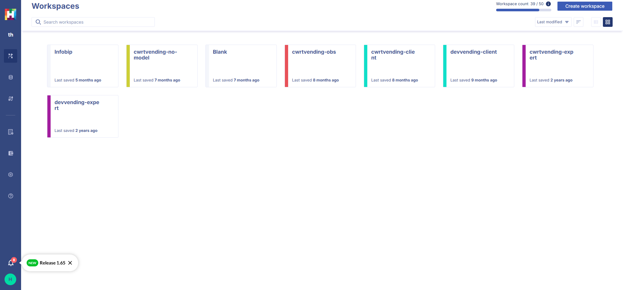
Releases 1.65, and 1.65.1
Check the notification in tool https://app.getbeamer.com/hfstudio/
Notes:
40 turns average for Definity data

Slide 41
Representative environment
Notes:
40 turns average for Definity data

Slide 42
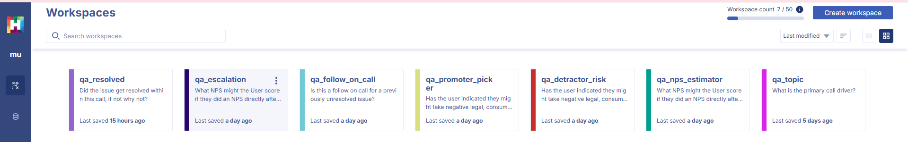
Replica Environment Built
ABCD Dataset (Action Based Conversation Dataset)
7 dimensions of analysis on single 1 convoset - representative prompts
Subdivided Small files ~ 167 each, 60 files in initial dataset, 10,000 calls
Average call length 20 turns
Repeated frequent update
Enables testing of updates to speed day to day running in this sort of situation
Notes:
40 turns average for Definity data 10,000 ~ 4 days can work up.

